Slide 1
Game Pitch
-- Fruit Fall Frenzy
Comprehensive Development Project
Ariel Zhao Liu
GEX - Sr. Winter 2025

Slide 2
CONTENTS
01
02
Game Overview
Gameplay Flow
03
04
Game Mechanics
Closing

Slide 3
Game Overview
01

Slide 4
Game Overview - Fruit Fall Frenzy
Concept: A magical fruit tree is under attack by mischievous spirits. Players must protect the tree by catching falling fruits to score points and avoid bombs that reduce lives. The gameplay becomes progressively challenging with increasing fruit and bomb speeds.
Features: Fast-paced arcade action with increasing difficulty, exciting power-ups, highest score tracking for replayability.
Target Audience: Casual players of all ages, particularly those who enjoy simple yet challenging gameplay.
Game Look: Hand-drawn art style, bold black-and-white linework and colored highlight.

Slide 5
Gameplay Flow
02

Slide 6
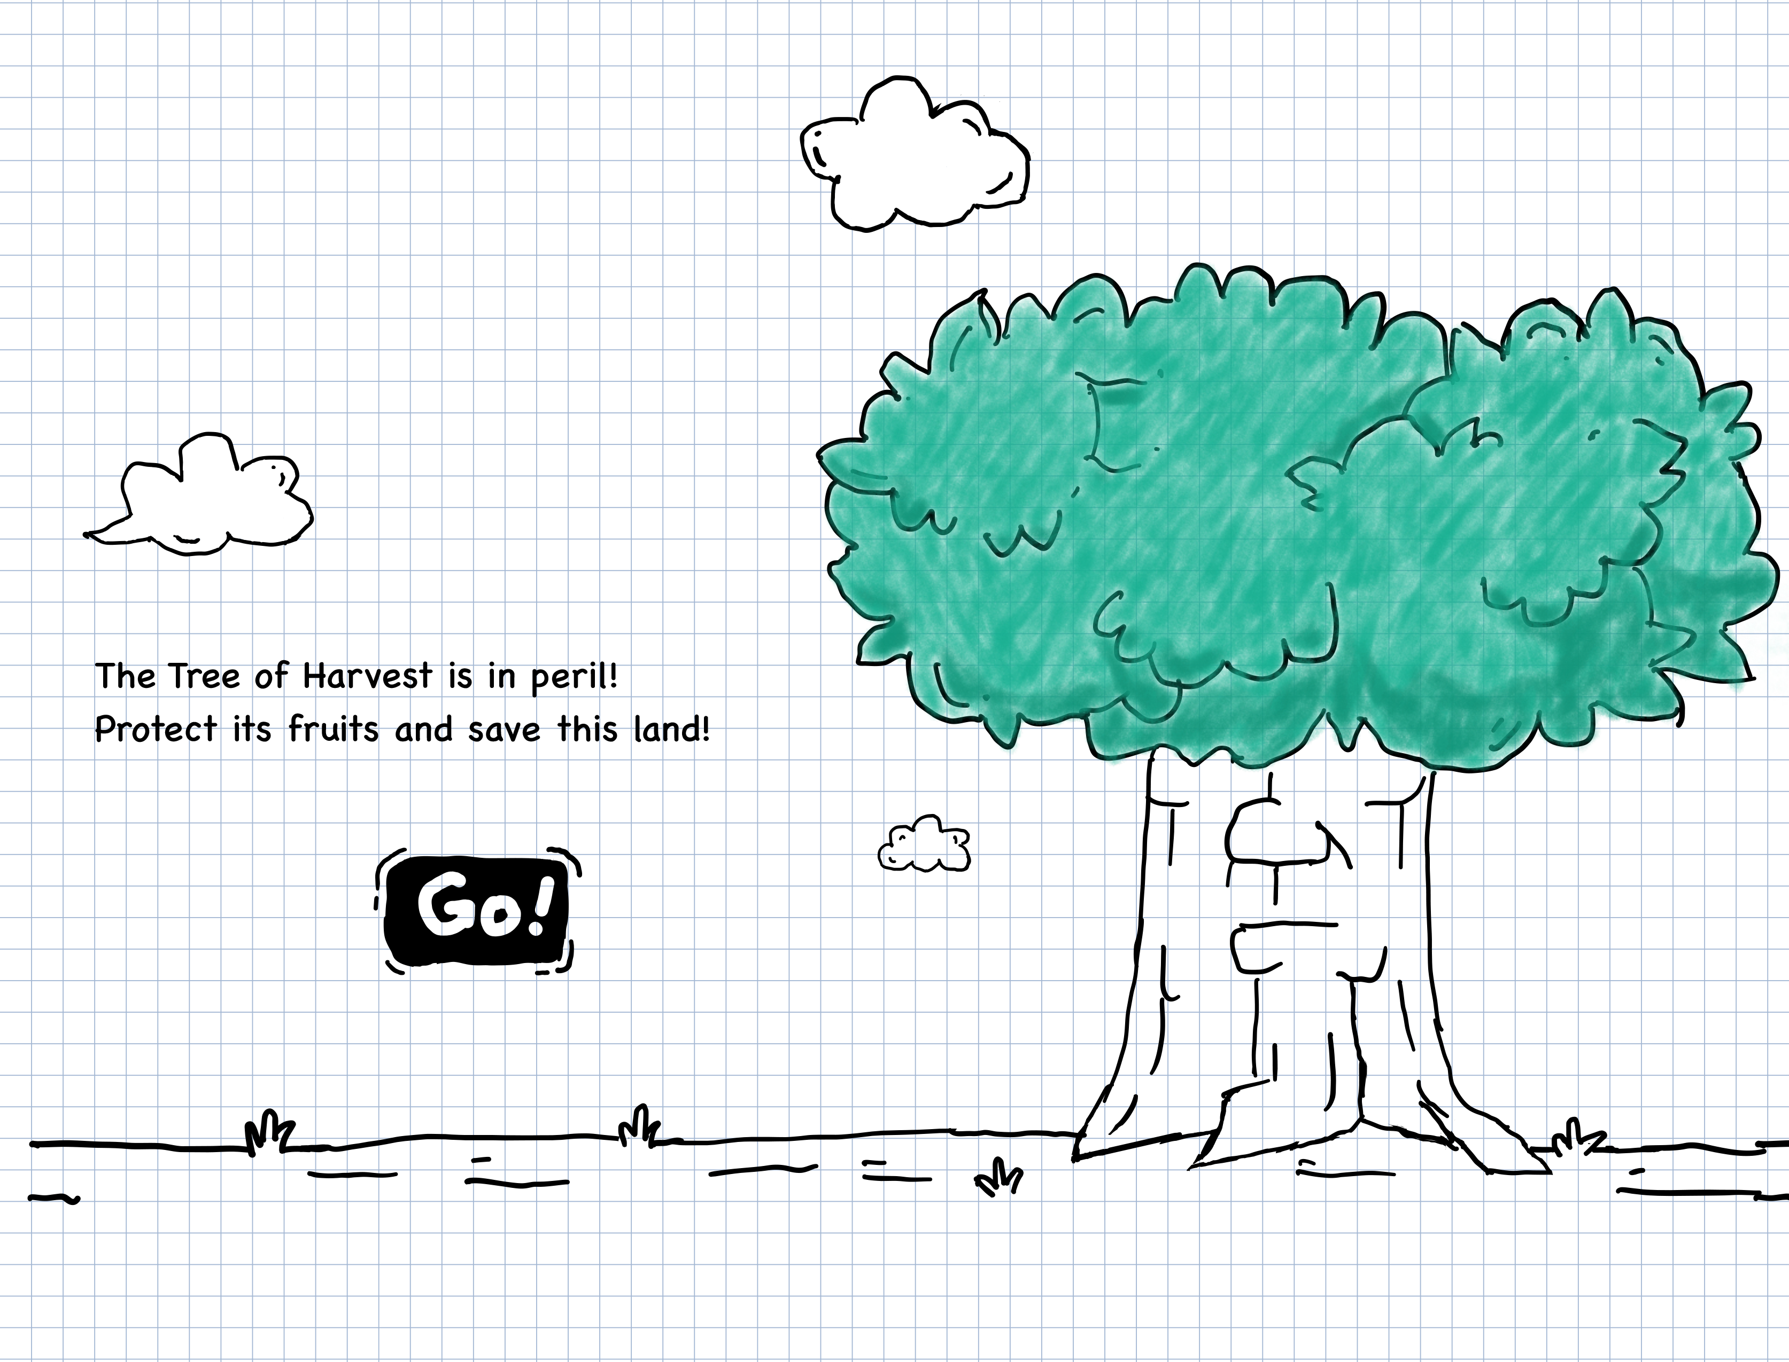
Splash Screen /
Main Menu

Slide 7
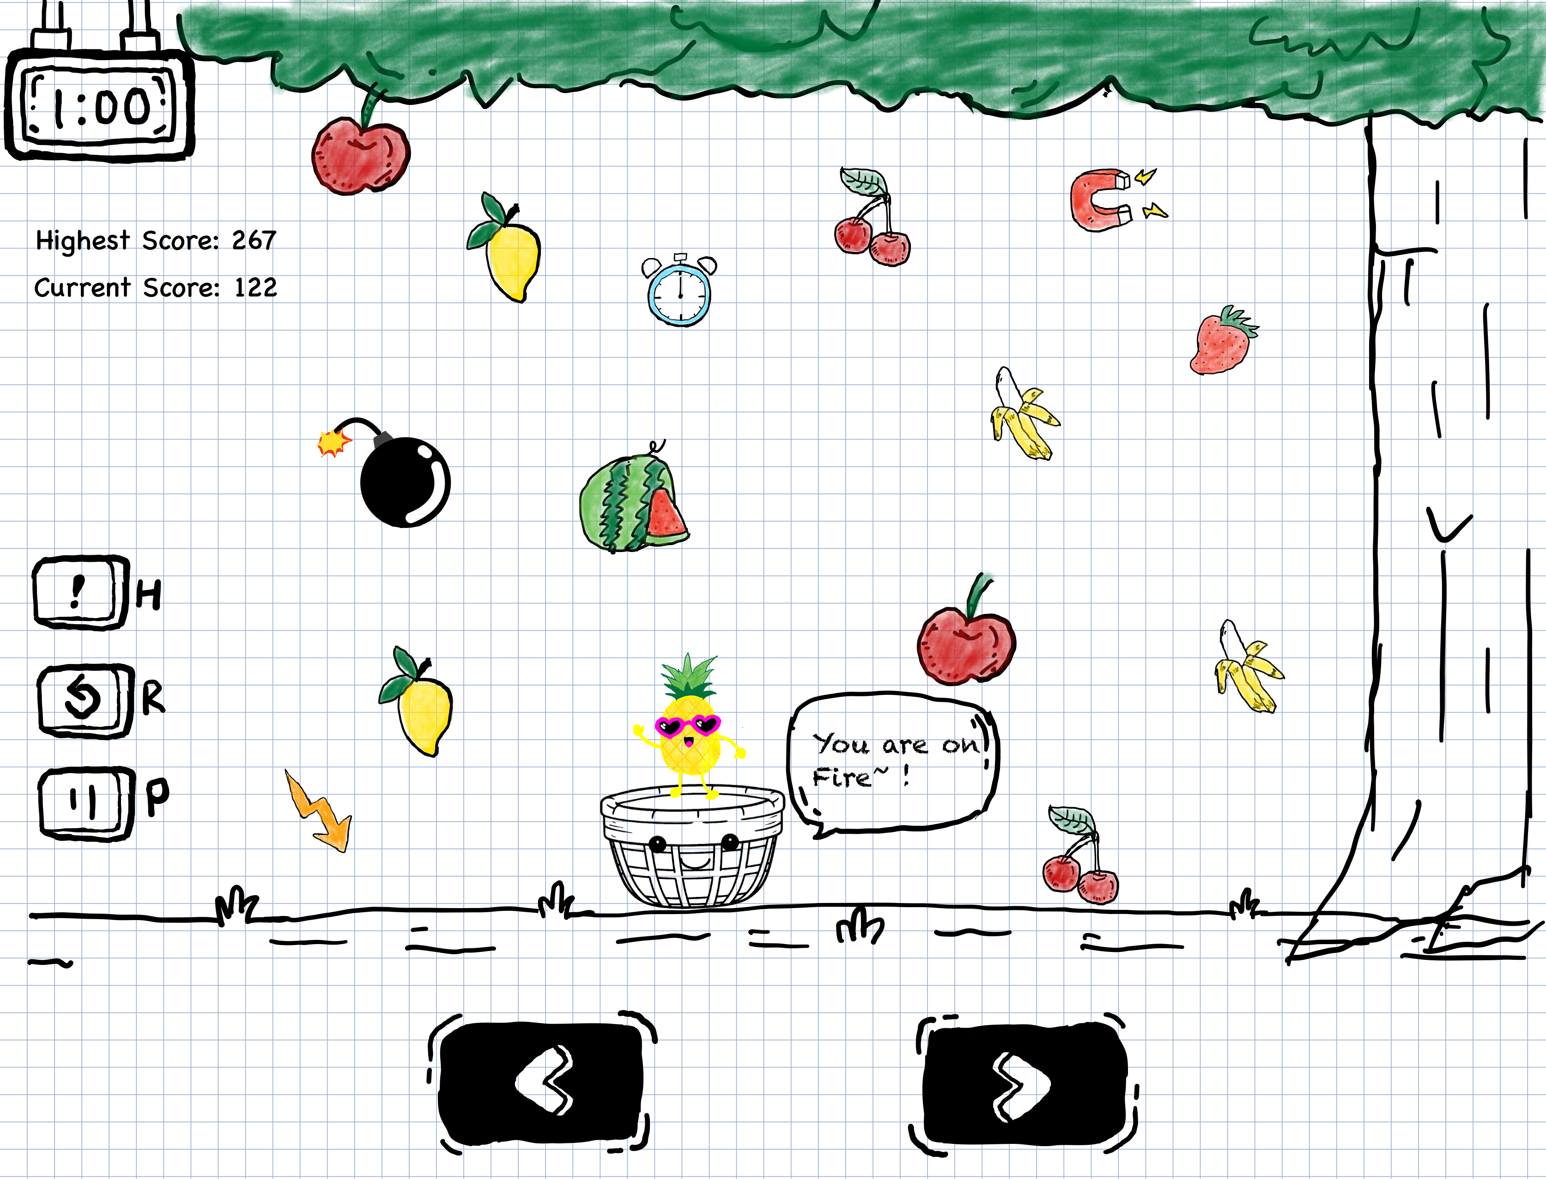
Gameplay Screen
Notes:
Player, Scores, Time, Meun,

Slide 8
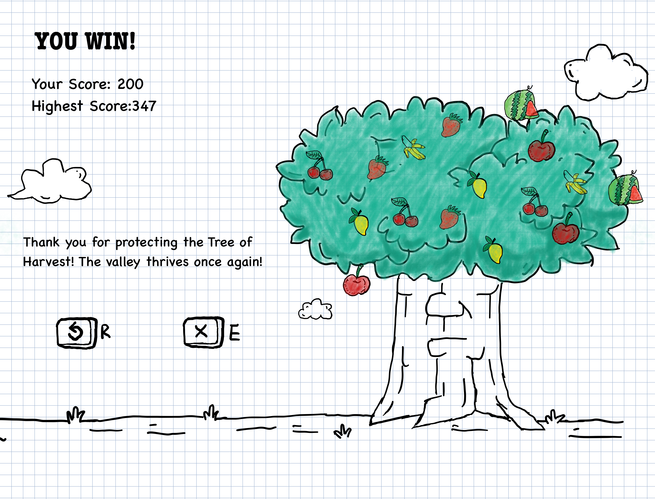
Victory Screen
Notes:
Win status, score, replay or exit

Slide 9
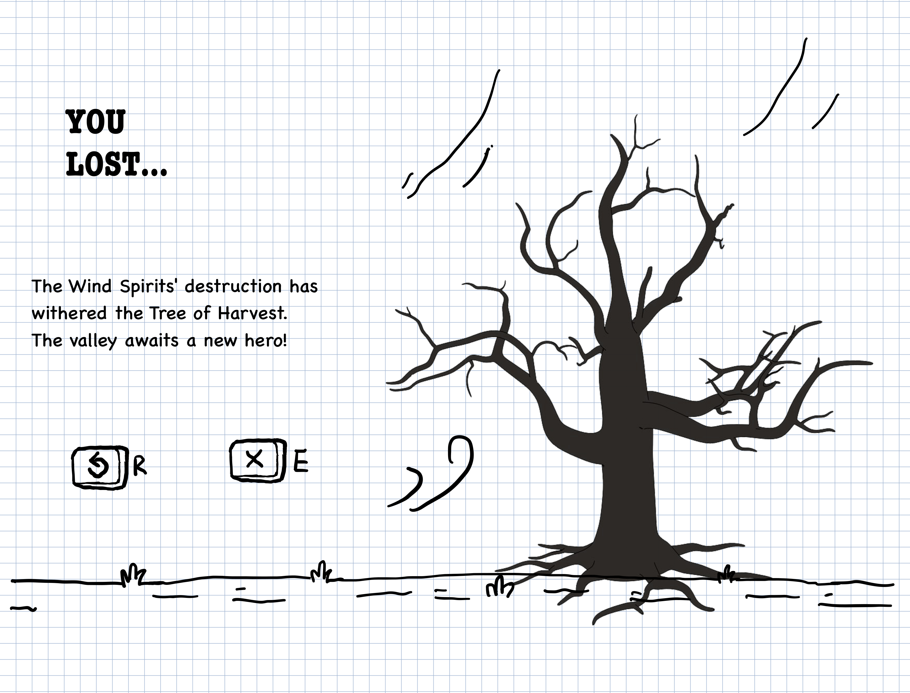
Failure Screen
Notes:
loose status, replay or exit

Slide 10
Mechanics
03

Slide 11
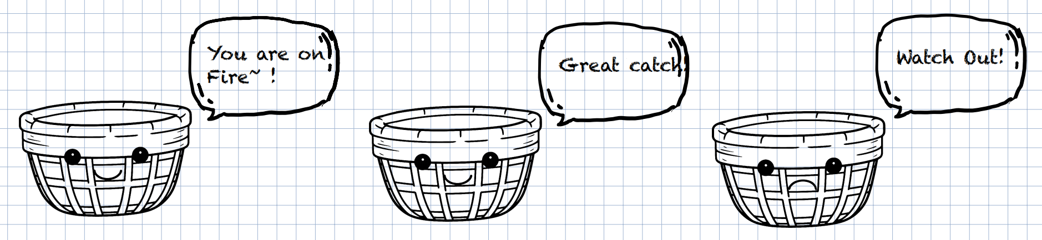
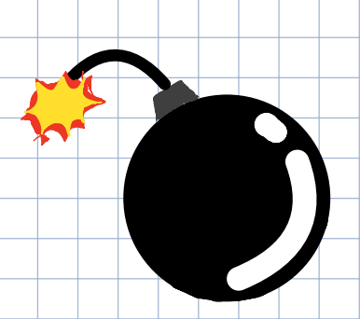
Game Mechanics
Core Mechanics:
Physics: Fruits and bombs fall in gravity-like arcs; Collision.
Player Controls: Use left/right keys to move the basket.

Slide 12
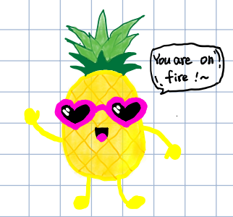
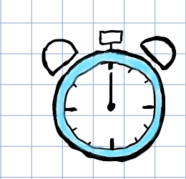
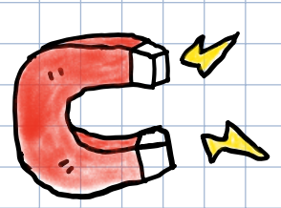
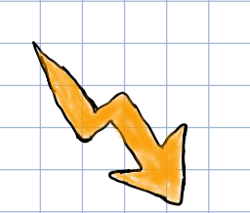
Game Mechanics
Power-Ups:
Time Extension: +5 seconds to the game timer.
Magnet: Attracts all fruits for 5 seconds.
Ice: Freezes bombs for 5 seconds.
Slow Motion: Slows object speed.
Golden Fruit: Doubles score.
Fruit Frenzy: Triggers a bomb-free fruit rain.

Slide 13
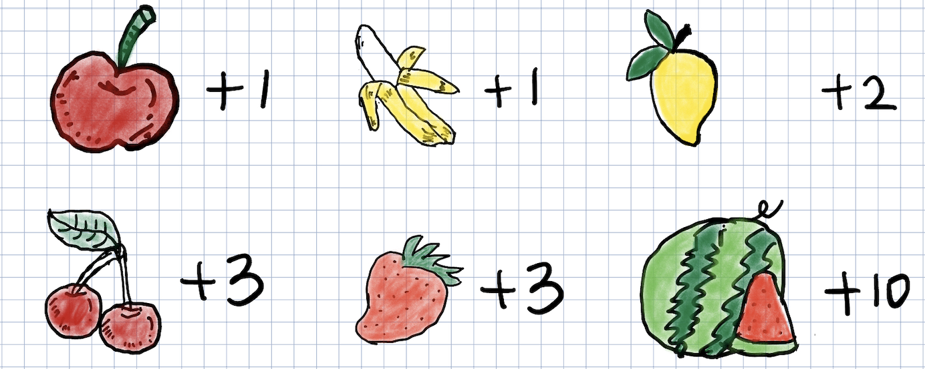
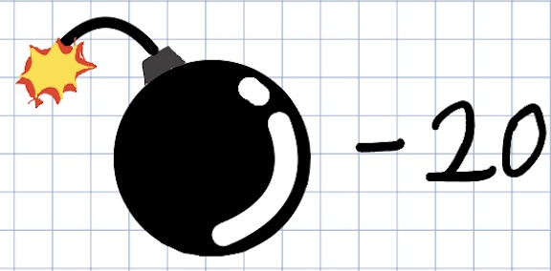
Scoring and Progression
Scoring System:
Fruits: Different fruits account for different points. 1-10 points.
Bombs: Deduct 20 points for catching a bomb.
Combo Bonus: Extra points for catching 10 fruits consecutively.

Slide 14
Scoring and Progression
Game Progression:
0–5 seconds: A few fruits fall with no bombs.
5–10s: A few bombs are introduced, and the fruit speed is moderate.
After 10s: The falling speed increases slightly.
After 15s: Random power-ups start to appear.
After 30s: The falling speed increases further.
40–50s: Peak intensity—fruits and bombs fall at the fastest speed and in the highest quantities.
50s to end: The game slows down, with a normal quantity and speed of fruits and bombs for a smoother conclusion.
The ratio of fruits and bombs：
Early Stage: 90% fruits, 10% bombs.
Middle Stage: 70% fruits, 30% bombs.
Later Stage: 60% fruits, 40% bombs for added challenge.

Slide 15
Closing
04

Slide 16
Closing
Easy to learn, hard to master mechanics.
Increasing difficulty and diverse stages keep players engaged.
Encourages quick thinking and coordination.
Expandable design, later could introduce seasonal themes fruits, unlockable tree growth stages

Slide 17
THANK YOU
Ariel Zhao Liu

